Slide 1

British airways virtual internship- Costumer review analysis
23/10/2023

Slide 2
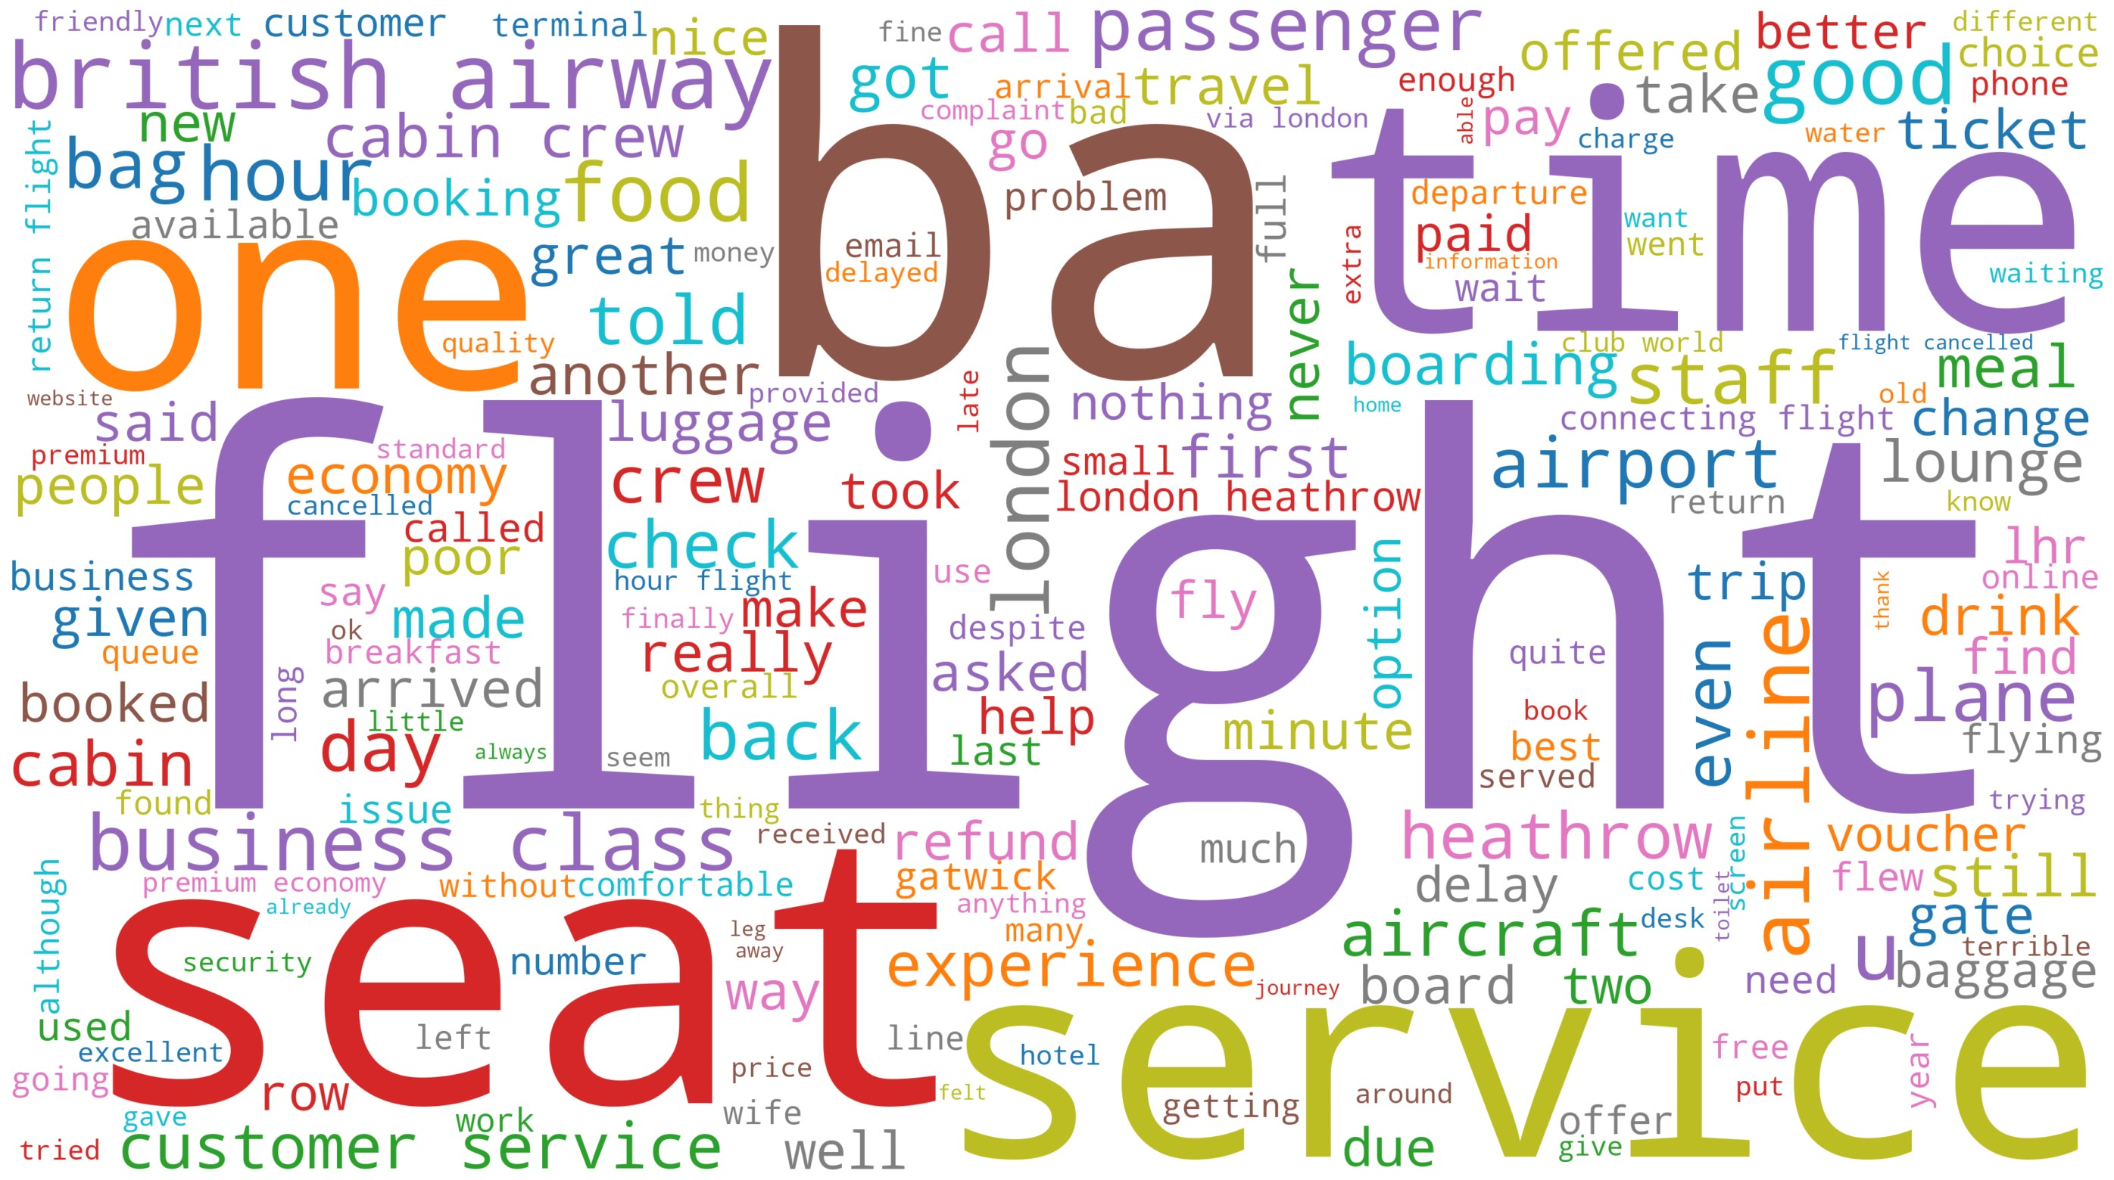
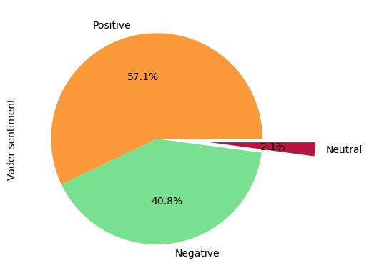
Costumer reviews insights
Word Cloud- most common words used in 1000 reviews
Out of 1000 reviews 57% were positive, 41% were negative and 2% were neutral. Overall the reviews sentiment lean towards positive and negative.

